Slide 1

Adventures with Spotify!
davemateer at gmail.com
github.com/djhmateer
Notes:
Excited to be here and talk about my adventures in Spotify.. Thanks for coming!
Slides videos in powerpoint and code on github
Will display links at end too
My name is Dave.. Developer 14 years.
Day job is….

Slide 2








Thanks Quorum (Dave’s employer)
Notes:
45 employees in Quorum, based in Edinburgh. The kind of clients we work with
I work out of the Brighton office
C sharp, and VB.. SQL

Slide 3

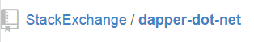


What’s in this talk for Me?
“How to Query a RESTful API using .NET”
C# 4.5 Async Await
log4net
Notes:
Conference top tips
1 – too easy, get bored.. Seen it all before. PLEASE LEAVE AT ANY POINT… no problem!! Even bathroom break..
2 – too hard.. Have no idea what is going on.. PLEASE STOP ME AT AT POINT… if you’ve lost someone else will be too… PLEASE HELP THEM OUT ☺
What am I going to talk about????

Slide 4
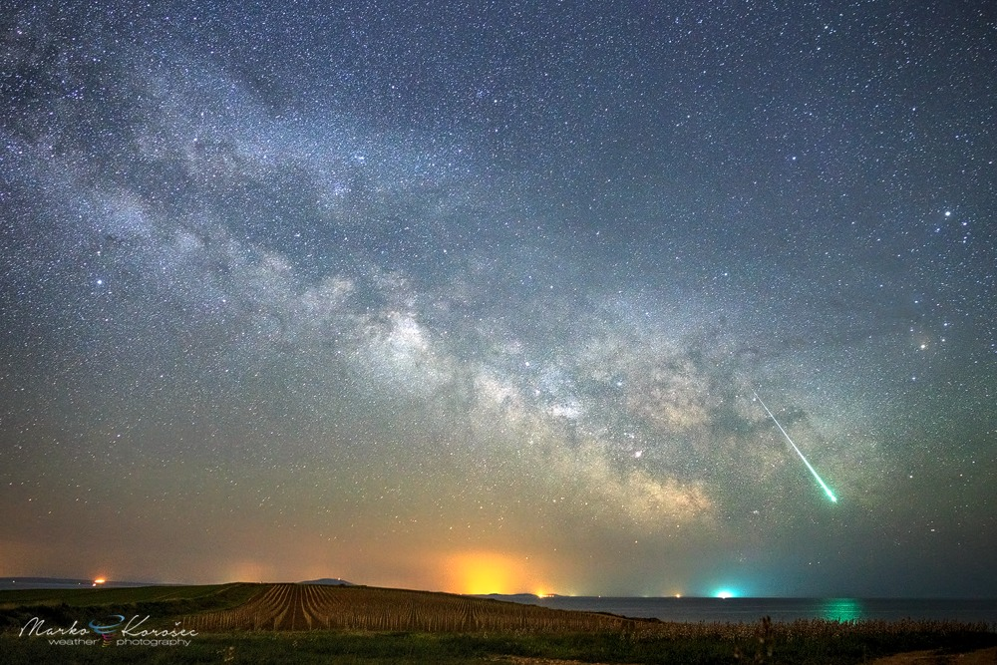






“How to Query a RESTful API using .NET”
Notes:
Google eath data
Astronomy picture of the day

Slide 5
Remember
“If you don’t understand what that bloke at the front is going on about… shout…or something!"

Slide 6
The Problem
"While coding at work I want to listen to great songs and albums that I know"
Notes:
So I was curious about Spotify and I set out to find out more.
Built website, purely for fun, to help me navigate the 38m songs in Spotify.

Slide 7
Ahhhh
Can I do better than the Spotify client??
Notes:
So I was curious about Spotify and I set out to find out more.
Built website, purely for fun, to help me navigate the 38m songs in Spotify.

Slide 8
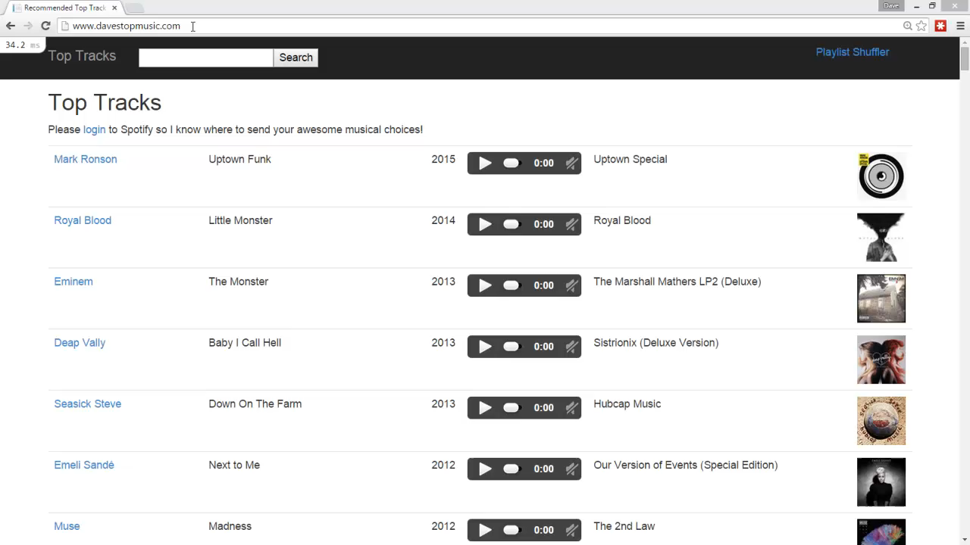

Slide 9
What is Spotify?
Music streaming service
2008, Sweden, 60m (15m paid) Users, 38m tracks

Slide 10
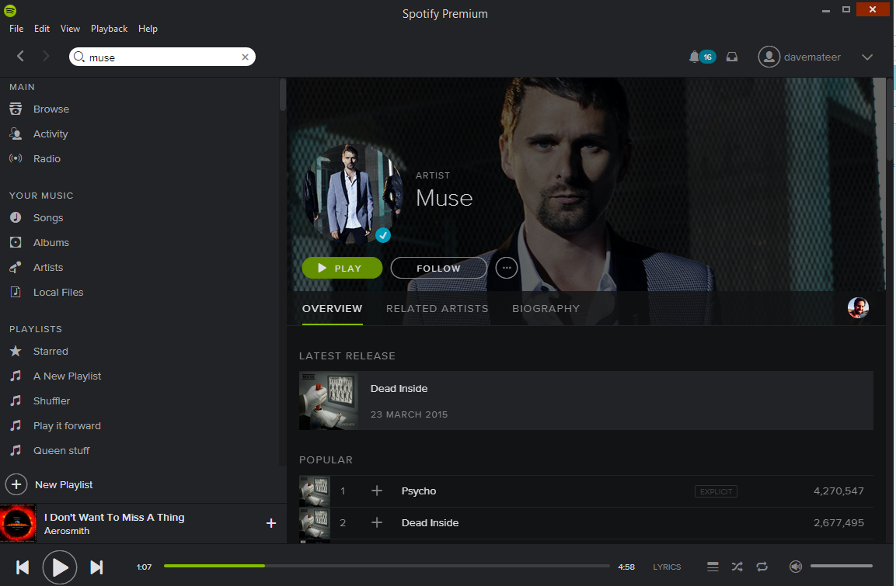
What is Spotify?

Slide 11
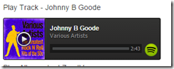
Embed
iframe src="https://embed.spotify.com/?uri=spotify:track:0mDHS1Q7HGtpgjYAyG2Svn">

Slide 12
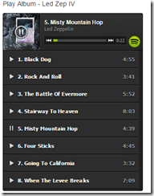
Embed Album / Playlist
iframe src="https://embed.spotify.com/?uri=spotify:user:hoxsd:playlist:0Z7jXtAId643ujM1UPshcte“

Slide 13
There is a RESTful API…
Explore Spotify catalogue
Create and add tracks to playlists

Slide 14
Query API via Chrome

Slide 15
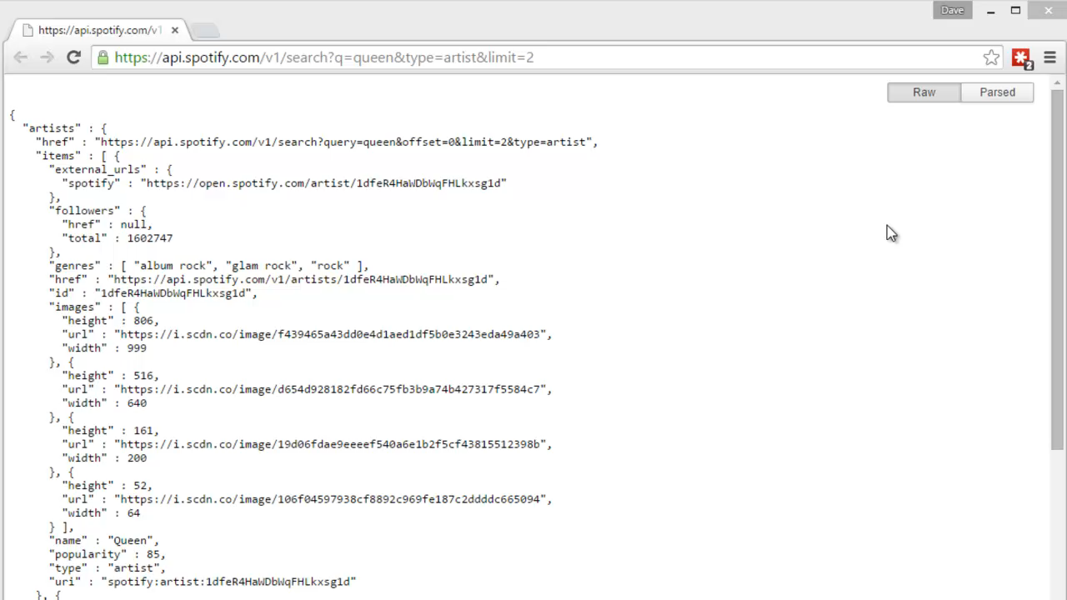

Slide 16
Query API via Console App

Slide 17
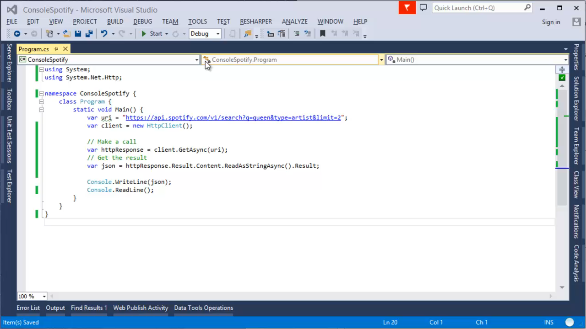
Console App

Slide 18
Deserialise

Slide 19
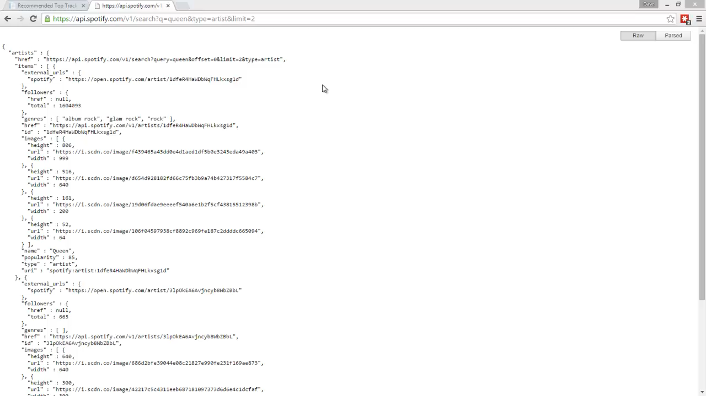
Console App

Slide 20
Website ASP.NET MVC5

Slide 21
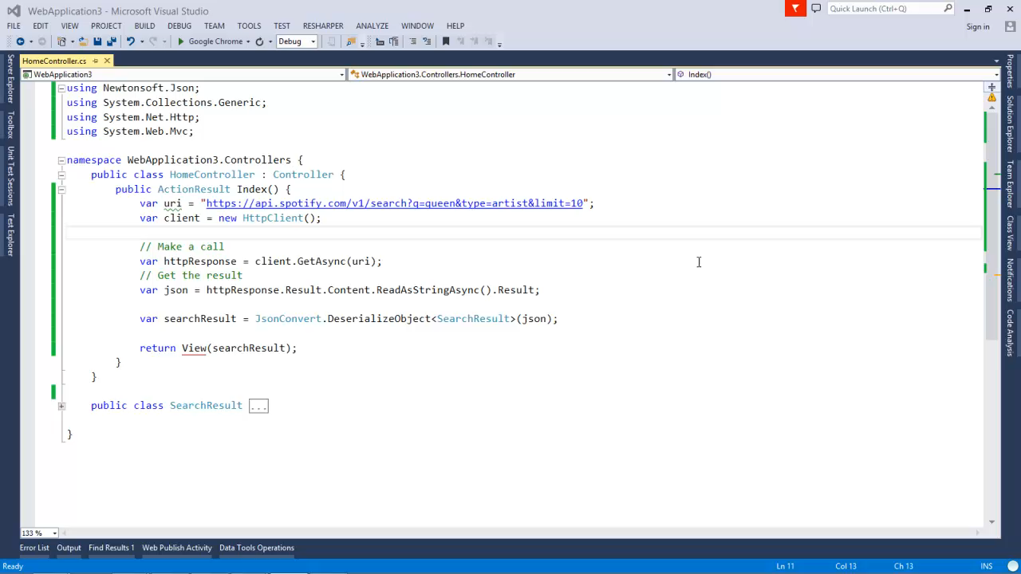
Console App

Slide 22
How it works!
Notes:
GET POST PUT DELETE

Slide 23
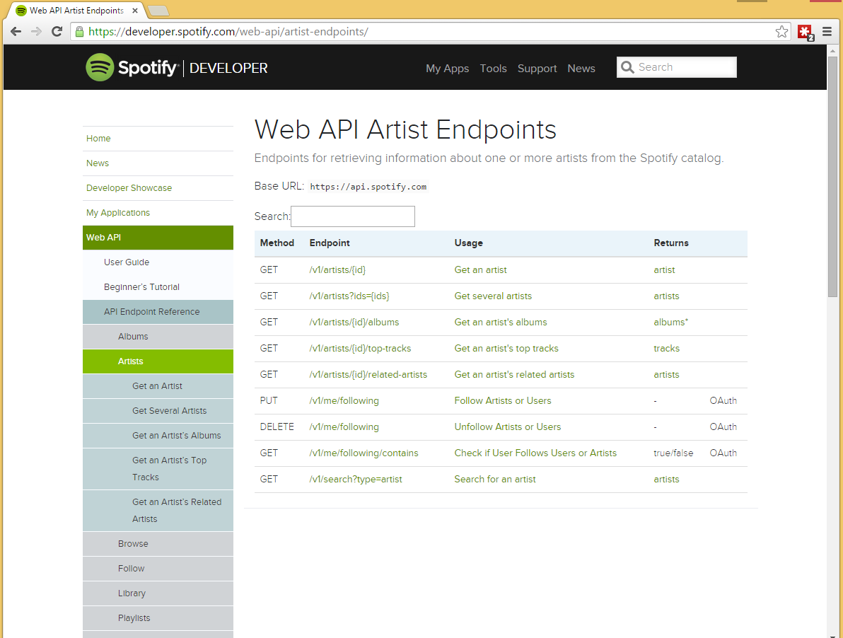
Notes:
GET POST PUT DELETE

Slide 24
Look at internals of the website
Notes:
Include ajax buttons here

Slide 25
OAuth2

Slide 26
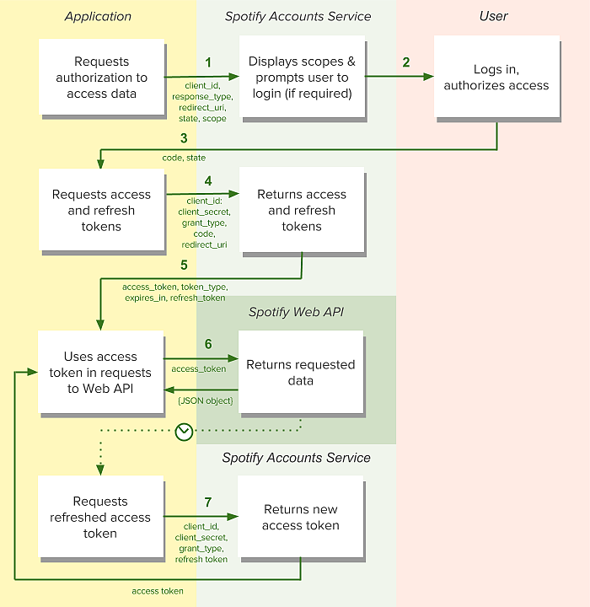

Slide 27
PlaylistShuffler
“That’s 100% made of awesome!” Jaume
“With this cool wee app now I’m gonna merge all the playlists… basically build the ultimate road trip playlist. Incredible effort mate”, Jaume
Notes:
Just demo it

Slide 28
MiniProfiler

Slide 29
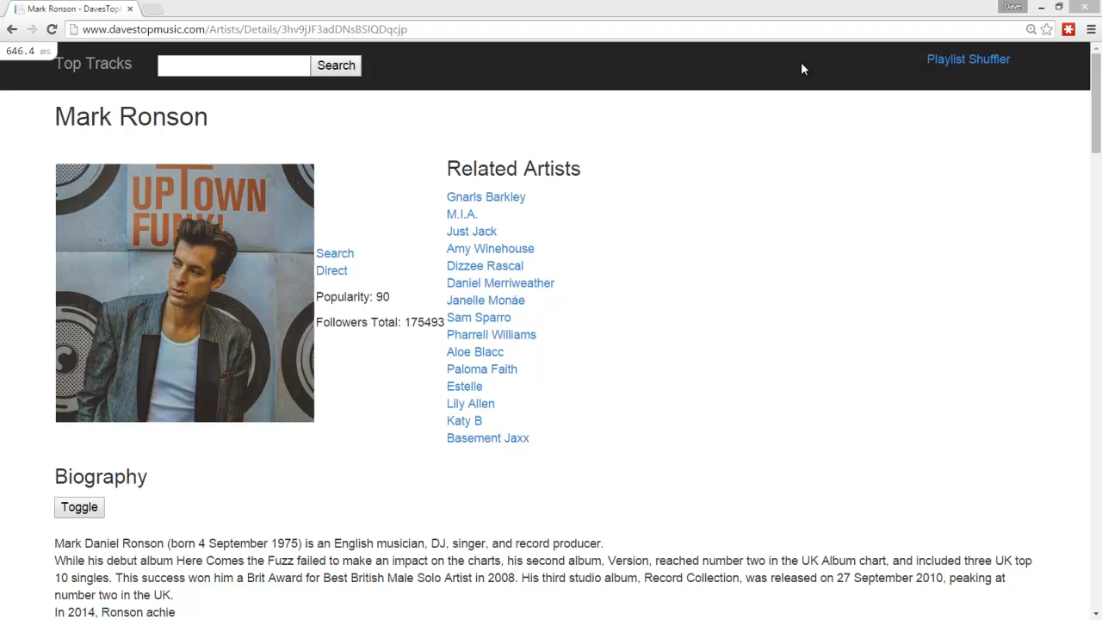
..

Slide 30
log4net

Slide 31
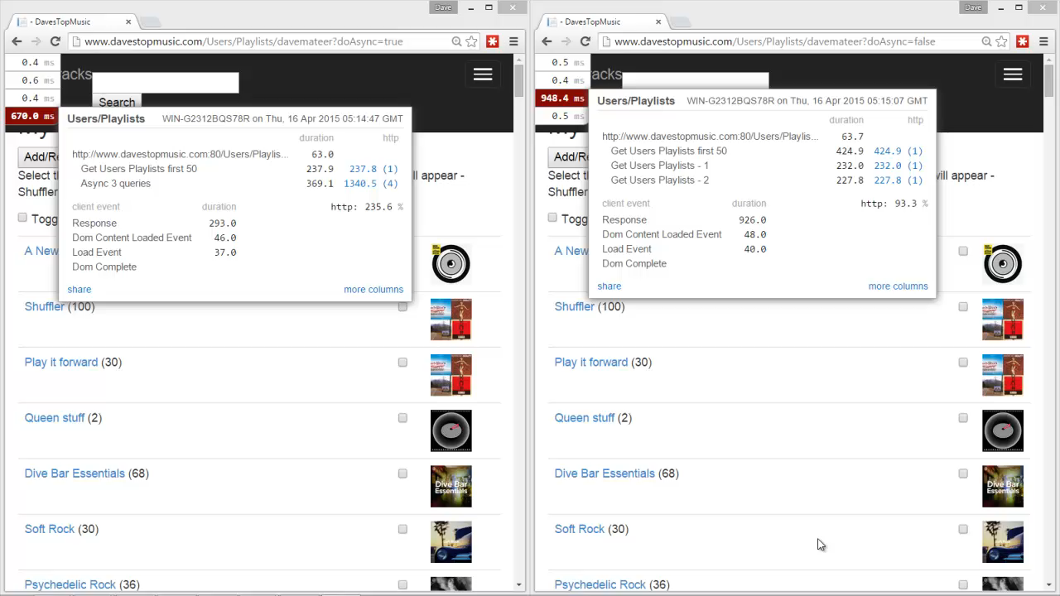
..
Notes:
Get 50 playlists at a time
Have to get the first one synchnously so know how many calls to do async
union at the bottom to aggregate results

Slide 32
Asynchronous
Notes:
Fun – wanted to explore doing things in parallel.
Do simple example of task wait - 5AsyncConsole
Do web example 5 – 5AsyncWeb

Slide 33
..
Notes:
Get 50 playlists at a time
Have to get the first one synchnously so know how many calls to do async
union at the bottom to aggregate results

Slide 34
Dapper – a Micro Object Relational Mapper

Slide 35
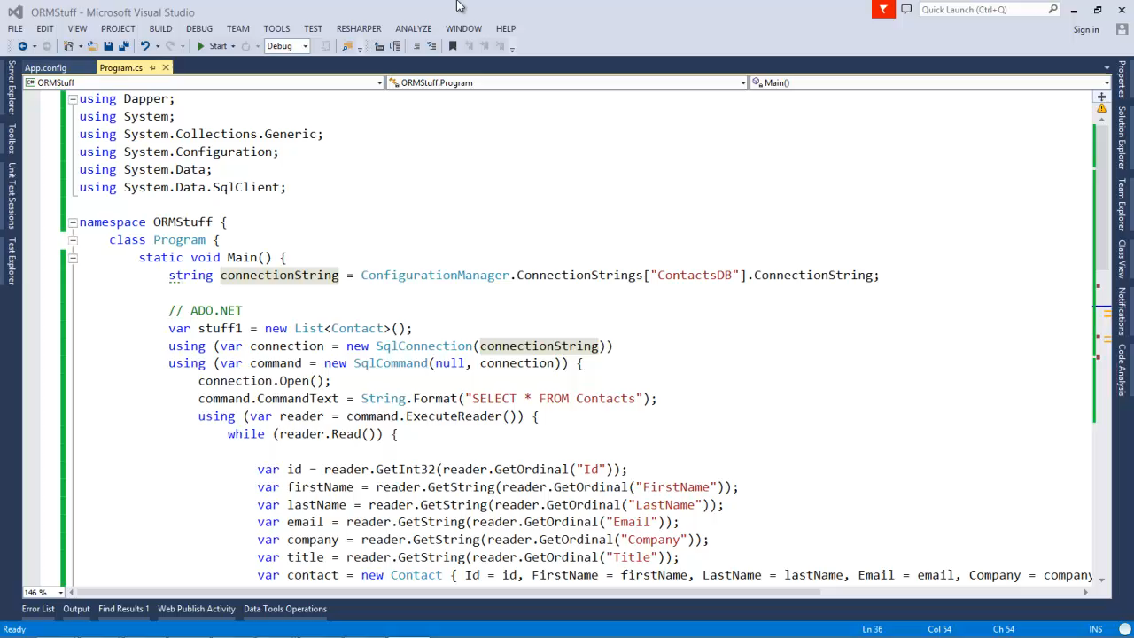
..

Slide 36
Deploying – MSDeploy and Appveyor

Slide 37
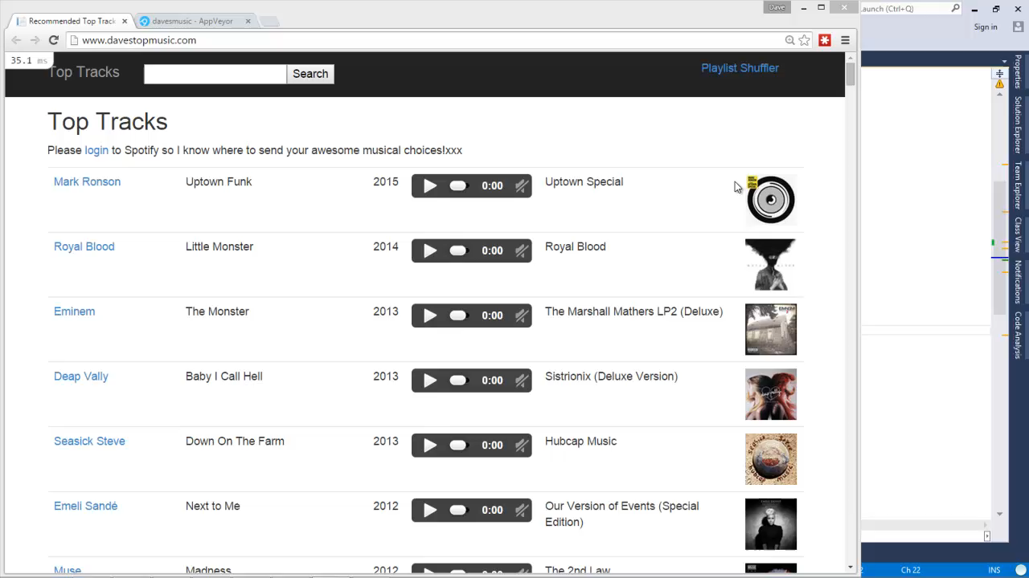
..

Slide 38
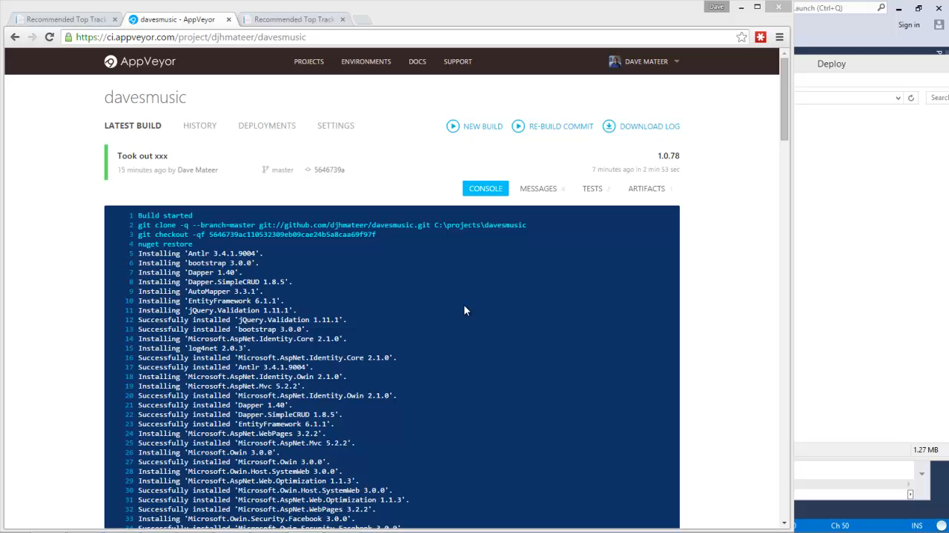
…

Slide 39
Music!
Suggestions for a
band or song to lookup? ☺
Notes:
What are your great songs of all time?
First record / single / tape / download you ever bought?
First gig?

Slide 40
Where to next?
This is a Spike
Notes:
Ordering of tracks in Spotify
Wrong track being linked (multiple versions of a track)
Date problem
User Stories revisit
Tags on songs?
I want to listen to disco
I want multi dtm playlists
Full rewrite - Clean code
TDD it
DI
Test WebClient
mock out API
Selenium style testing
Last.fm

Slide 41
Testing and Where Next..
Selenium
Mock out HttpClient
TDD out the real app
DI (Pure DI)
Throw away this spike
Write User Stories!
Tags eg Disco, Rock, 80s??

Slide 42
Summary
Embed Spotify in web pages
Console Apps to spike
Spotify Web API
ASP.NET MVC
Async
Dapper (ORM)
MiniProfiler
Log4Net
Deploying Appveyor
Azure and EC
Music that inspires you?
davemateer at gmail.com
github.com/djhmateer
www.davestopmusic.com

